Slide 1
Who are “DALITS”?
Untouchables of India.
Socially discriminated.
They said to be out of the social structure (the out caste).
Due to social binding not allowed to own any wealth and properties.
Economically suppressed.
Politically voiceless.

Slide 2
The Indian Social Stucture
It is a caste structured society.
This caste structure is proposed by the vedic scriptures.
Rig vedha Ch: 10 – “Purusha shutra” means the Theory of creation.
Keeping that as a base Manusmriti (the written code of Manu an ancient Hindu priest) classified a discriminative role in the society for each caste.

Slide 3
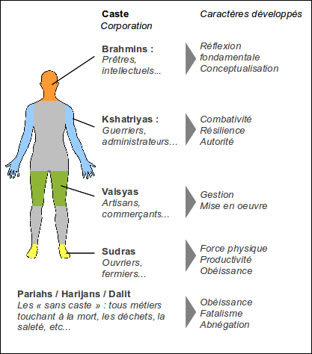
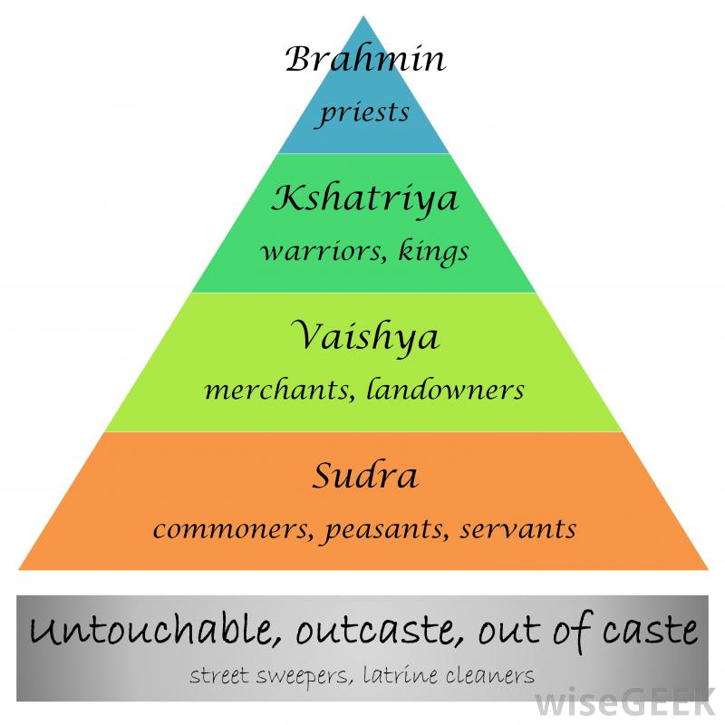
Theory of creation by Hindu Vedic code

Slide 4
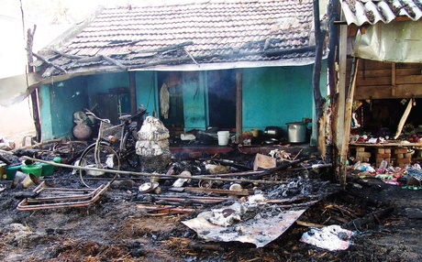
The present status of the Dalits
Ostracization.
They are murdered
distraction of property and livelihoods. (for dalits can’t be a owners).
They forced to extreme poverty and not allowed to access public facilities and wealth.
Forced to extreme social and political discrimination. Not allowed to take part in common human life and in decision making process of the society and the state.

Slide 5
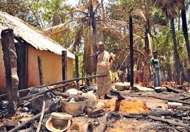
Forced to live in dependency, fear and with no human dignity
Kept in ignorance and fear always.
Face innumerable Humiliations
fatalistic- forced to feel inferior

Slide 6
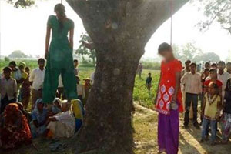
Dalit women
Humiliation in all levels
Brutally Raped - gang raped and murder.
Not allowed for education
Feminization of poverty highly affects them
Forcible honour killing
Never take a courageous public participation
The girls, aged 14 and 15, who are lowest dalit ‘untouchable’ caste, had been kidnapped by a upper caste men… evening after they left their homes to go to the toilet in a nearby field. (POLICE DISMISS FATHER’S PLEAS FOR HELP)

Slide 7
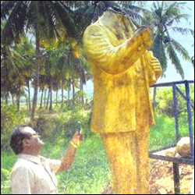
Dalits and the State
Dalits are politically oppressed and voiceless
Can’t enjoy any authority
Powerless & degraded, dehumanized.
Even in holding authority Dalits can’t decide.
Govt Laws & policies doesn’t reach them

Slide 8
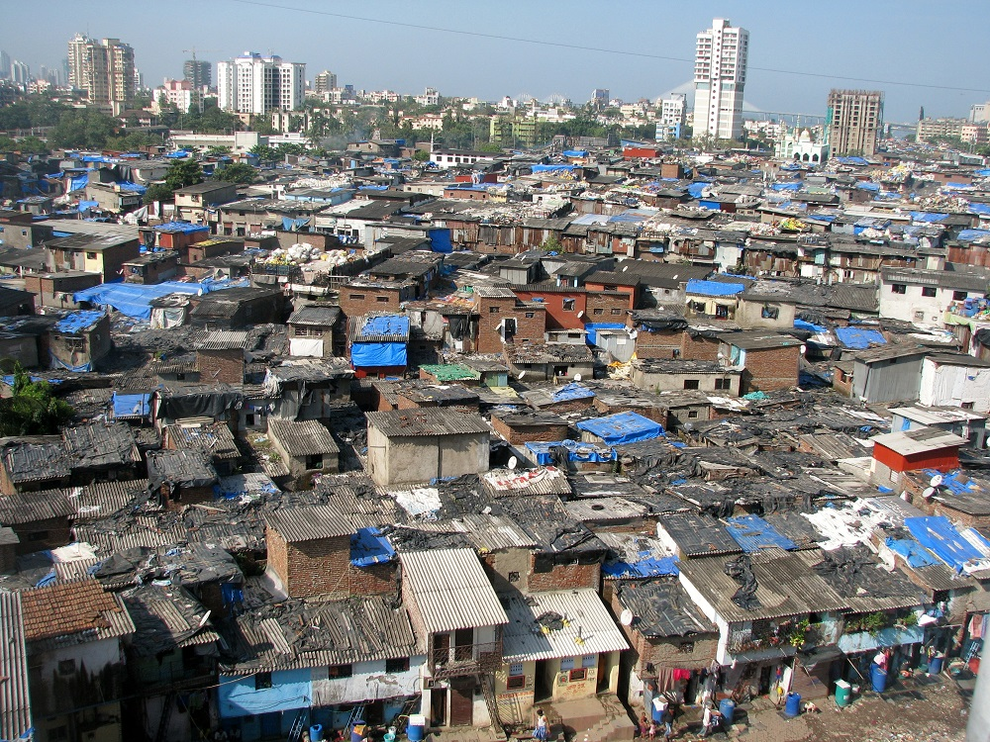
The consequence
Often dalits migrate. Sheltered in slums of the urban outskirts, especially men folk for livelihood.
Women are forced for poverty (feminization of poverty, sexual harassments in the village)
Exploited for alcoholism
Lack of opportunities

Slide 9
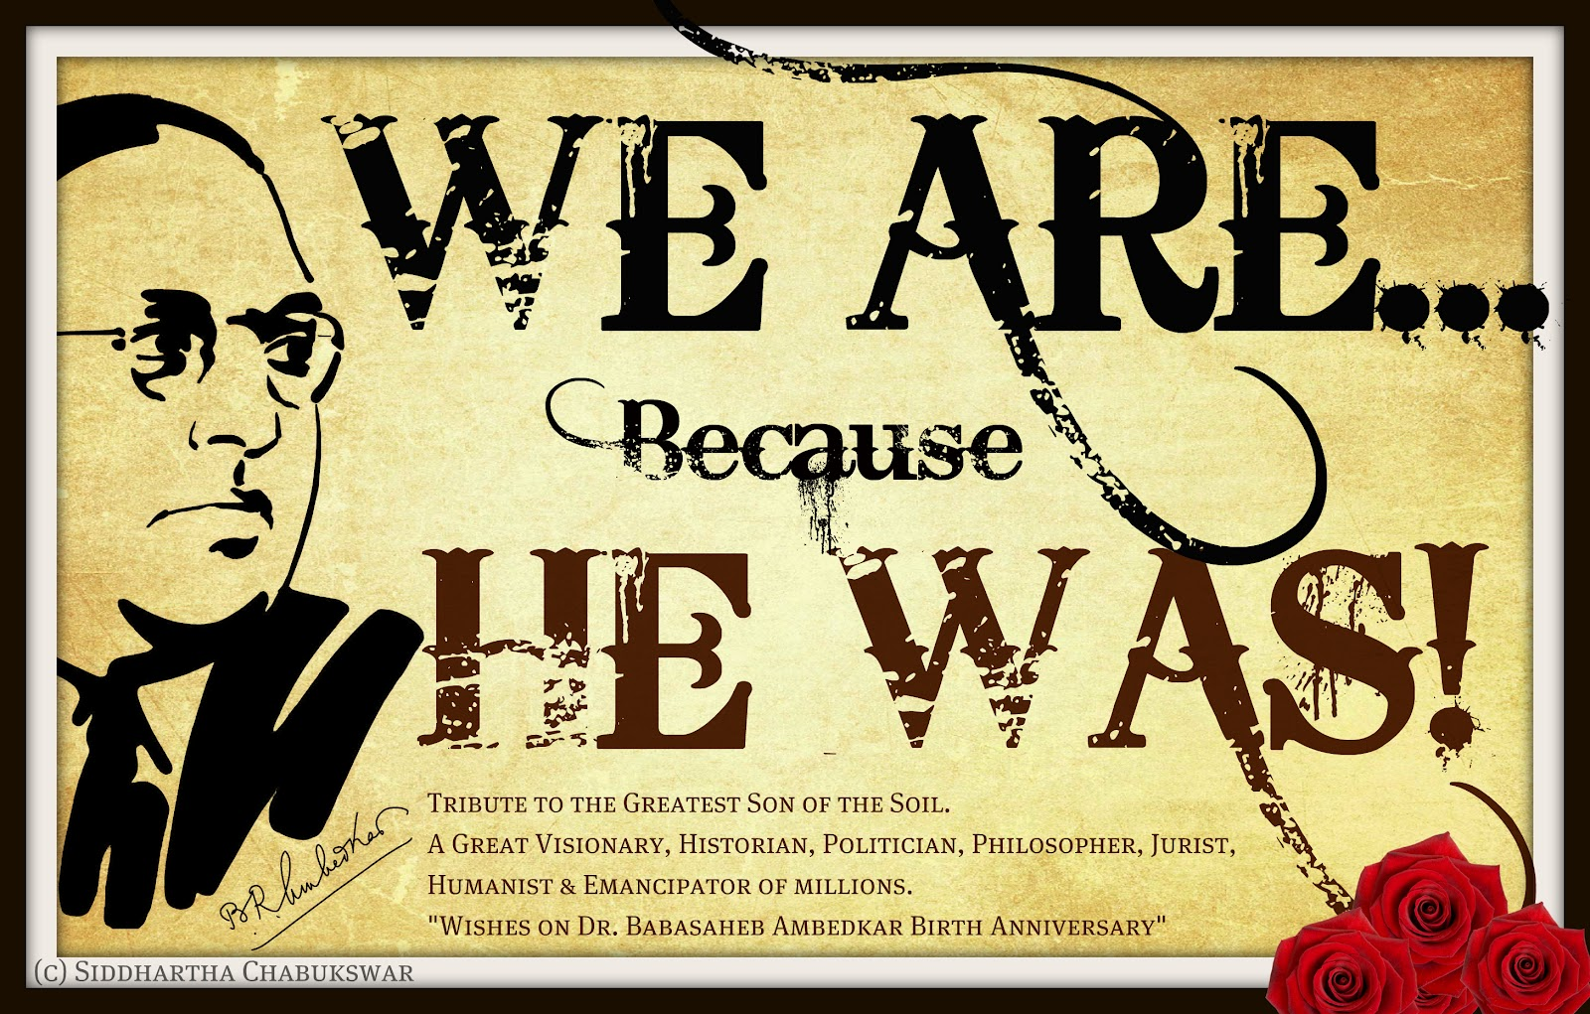
The other side or the other reality
The oppressed Dalits Resisted, right from the beginning
1. Buddha to Ambedkar
3. Dalit Movements / Dalit Political Parties and Christian Missionaries

Slide 10
Culture of silence
culture of resistance
Dalits discover new methods and strategies,
Movementizing with alliances and keep struggling by mobilising dalits including women through organizing for political power.
Empowering by education - economic upliftment – connscientisation.
Through discoveringDalit culture, art & Dalit theatre.....
Inferior
Acceptance deniel of rights as ones fate
Fatalistic
Powerless and voiceless
Servants and slaves to others

Slide 11
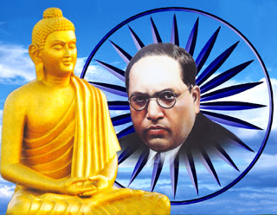
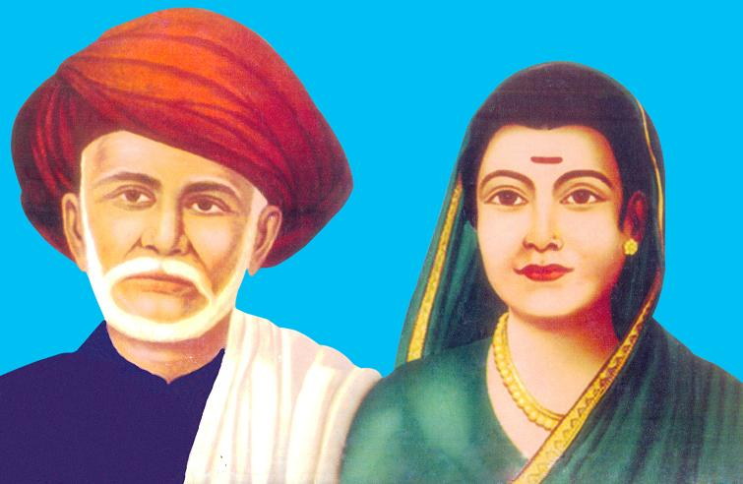
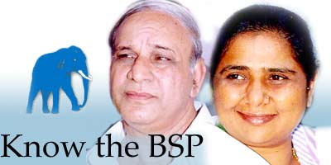
Political and cultural upraisal
Ambedkar as a role model
Individuals / movements / NGO’s / institutions / political parties resisting and re-creating
Conscientisation... Leadership efforts
Struggles and Fights for Rights
Rediscovering the strength of the community.... rediscovering traditional culture and art-forms

Slide 12
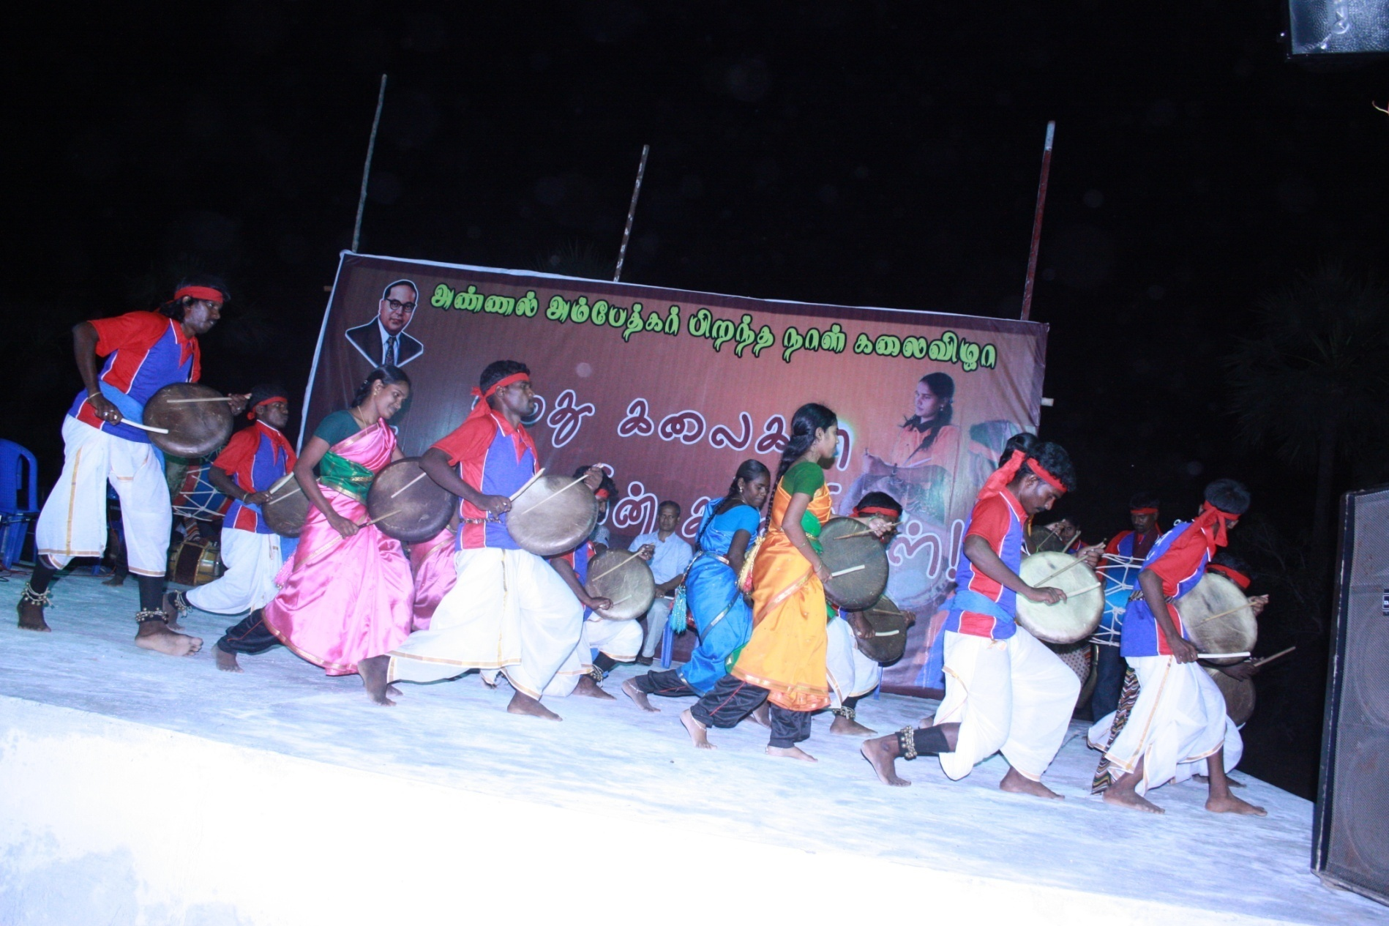
A Rich Cultural Heritage
Dalit Culture as tool and weapon.
A Culture of Inclusion; A culture of Celebration; A culture of healing
Communitarian and collectively wise: Militant, Inelegant, Resistance
Nature – loving

Slide 13
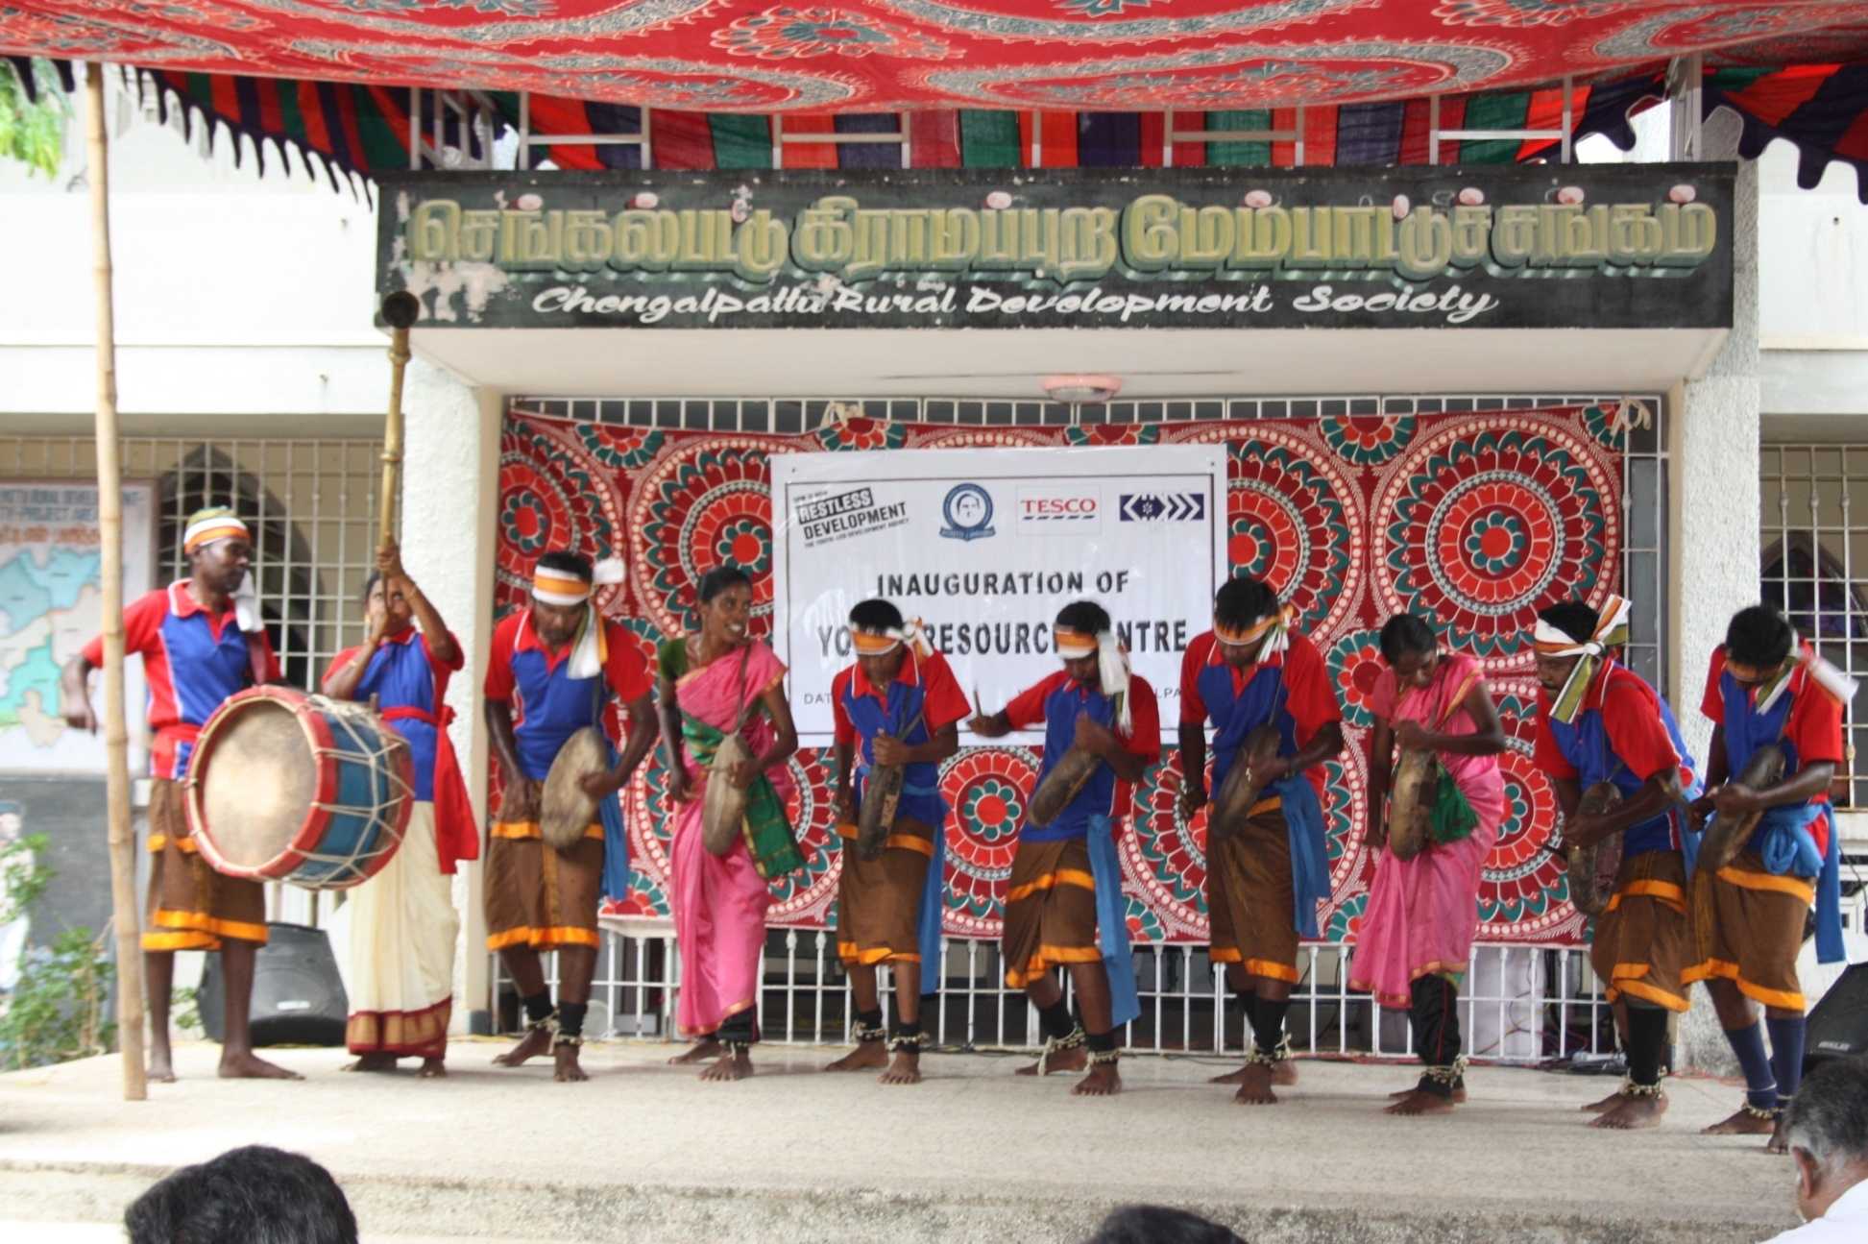
DALIT CULTURE.... DALIT ART-FORMS.... DALIT THEATRE
Dalit folk arts keeps them together in a spirit of joy and sharing
Gives space for expression of their anger as well as of hope
Dalit Theatre has emerged as a historical need – to create awareness.... recapture the lost humanity.....

Slide 14
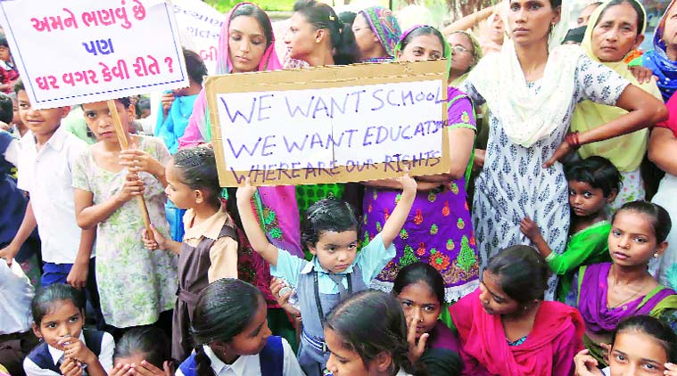
Education for Dalit as tool and weapon.
The present generation feels that it is only through
education that changes are possible in the life of Dalits. As Dr B R Ambedkar told Education is our last weapon.

Slide 15
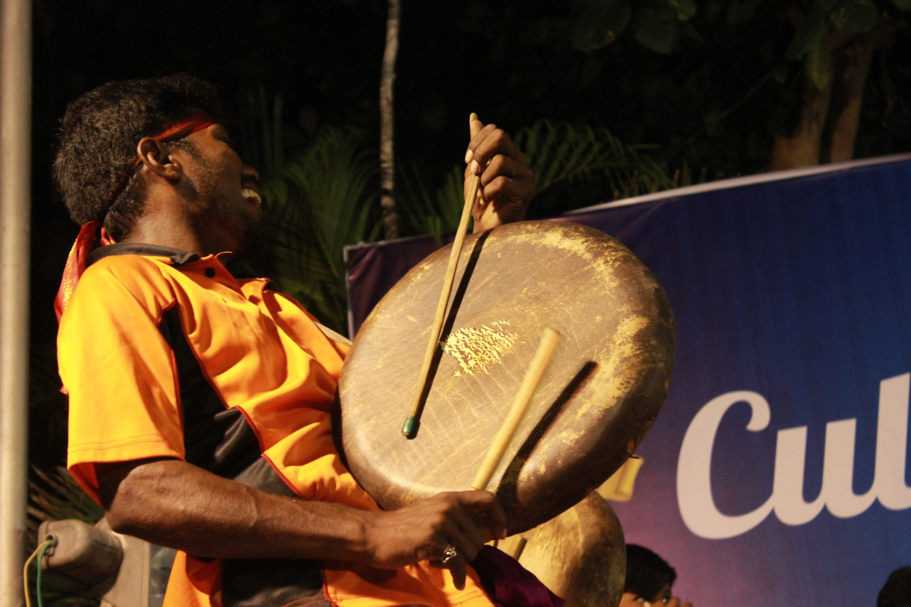
THANK YOU

